Slide 1
Laboratory Work 1: ERD Diagram - International Airport
Student name: Kuttybaev Dmitrii
Student ID: 25B031326
1. Introduction
The goal of this lab is to design a simple database diagram (ERD) for an international airport. I will set up the main tables, connect them, and define the basic rules for how the airport database works.
2. Identified Entities
Entity | Purpose
Airport | Stores airport information: name, country, state, city, creation and update timestamps.
Airline | Stores airline company information including airline code, name, country, creation and update timestamps.
Flight | Stores scheduled and actual flight information, gates, airline, departure/arrival airports, and timestamps.
Passenger | Stores passenger personal and passport information.
Booking | Stores a passenger booking for a flight, its status, platform, ticket price, and timestamps.
Booking_Changes | Separate entity used to record changes made to a booking flight.
BoardingPass | Stores boarding pass information issued for a booking.
Baggage | Stores baggage registered during a booking, including weight and timestamps.
BaggageCheck | Stores the baggage checking result associated with a booking and passenger.
SecurityCheck | Stores airport security check information for a passenger.
1/8

Slide 2
3. Attributes, Keys and Data Types
Entity | Attribute | Type | Constraint | Description
Airport | airport_id | BIGINT | PK | Unique identifier.
Airport | airport_name | VARCHAR(150) | Required | Airport name.
Airport | country | VARCHAR(100) | Required | Country.
Airport | state | VARCHAR(100) | Optional | State/region.
Airport | city | VARCHAR(100) | Required | City.
Airport | created_at | TIMESTAMP | Required | Creation time.
Airport | updated_at | TIMESTAMP | Required | Last update time.
Airline | airline_id | BIGINT | PK | Unique identifier.
Airline | airline_code | VARCHAR(10) | Required / UQ | Airline code.
Airline | name | VARCHAR(150) | Required | Airline name.
Airline | country | VARCHAR(100) | Required | Country.
Airline | created_at | TIMESTAMP | Required | Creation time.
Airline | updated_at | TIMESTAMP | Required | Last update time.
Flight | flight_id | BIGINT | PK | Unique identifier.
Flight | departing_gate | VARCHAR(10) | Optional | Departure gate.
Flight | arriving_gate | VARCHAR(10) | Optional | Arrival gate.
Flight | airline_id | BIGINT | FK | References Airline.
Flight | departure_airport_id | BIGINT | FK | References Airport.
Flight | arrival_airport_id | BIGINT | FK | References Airport.
Flight | scheduled_departure_time | TIMESTAMP | Required | Scheduled departure time.
Flight | scheduled_arrival_time | TIMESTAMP | Required | Scheduled arrival time.
Flight | actual_departure_time | TIMESTAMP | Optional | Actual departure time.
Flight | actual_arrival_time | TIMESTAMP | Optional | Actual arrival time.
Flight | created_at / updated_at | TIMESTAMP | Required | Audit timestamps.

Slide 3
3. Attributes, Keys and Data Types — Continued
Entity | Attribute | Type | Constraint | Description
Passenger | passenger_id | BIGINT | PK | Unique identifier.
Passenger | first_name | VARCHAR(100) | Required | First name.
Passenger | last_name | VARCHAR(100) | Required | Last name.
Passenger | gender | VARCHAR(20) | Required | Gender.
Passenger | date_of_birth | DATE | Required | Date of birth.
Passenger | country_of_citizenship | VARCHAR(100) | Required | Citizenship country.
Passenger | country_of_residence | VARCHAR(100) | Required | Residence country.
Passenger | passport_number | VARCHAR(30) | Required / UQ | Passport number.
Passenger | created_at / updated_at | TIMESTAMP | Required | Profile timestamps.
Booking | booking_id | BIGINT | PK | Unique identifier.
Booking | flight_id | BIGINT | FK | References Flight.
Booking | passenger_id | BIGINT | FK | References Passenger.
Booking | status | VARCHAR(30) | Required | Booking status.
Booking | booking_platform | VARCHAR(50) | Required | Platform used for booking.
Booking | ticket_price | NUMERIC(10,2) | Required | Ticket price.
Booking | created_at / updated_at | TIMESTAMP | Required | Booking timestamps.
Booking_Changes | change_id | BIGINT | PK | Unique identifier for change record.
Booking_Changes | booking_id | BIGINT | FK | References Booking.
Booking_Changes | old_flight_id | BIGINT | FK (recommended) | Flight before change.
Booking_Changes | new_flight_id | BIGINT | FK (recommended) | Flight after change.
Booking_Changes | change_reason | VARCHAR(255) | Optional | Reason for change.
Booking_Changes | changed_at | TIMESTAMP | Required | Change time.

Slide 4
3. Attributes, Keys and Data Types — Continued
Entity | Attribute | Type | Constraint | Description
BoardingPass | boarding_pass_id | BIGINT | PK | Unique identifier.
BoardingPass | seat | VARCHAR(10) | Required | Assigned seat.
BoardingPass | boarding_time | TIMESTAMP | Required | Boarding time.
BoardingPass | created_at / updated_at | TIMESTAMP | Required | Pass timestamps.
BoardingPass | booking_id | BIGINT | FK | References Booking.
Baggage | baggage_id | BIGINT | PK | Unique identifier.
Baggage | weight_kg | NUMERIC(6,2) | Required | Weight in kilograms.
Baggage | created_date / updated_date | TIMESTAMP | Required | Baggage timestamps.
Baggage | booking_id | BIGINT | FK | References Booking.
BaggageCheck | baggage_checking_id | BIGINT | PK | Unique identifier.
BaggageCheck | check_results | VARCHAR(30) | Required | Check result.
BaggageCheck | created_at / updated_at | TIMESTAMP | Required | Check timestamps.
BaggageCheck | booking_id | BIGINT | FK | References Booking.
BaggageCheck | passenger_id | BIGINT | FK | References Passenger.
SecurityCheck | security_check_id | BIGINT | PK | Unique identifier.
SecurityCheck | check_results | VARCHAR(30) | Required | Security check result.
SecurityCheck | created_at / updated_at | TIMESTAMP | Required | Check timestamps.
SecurityCheck | passenger_id | BIGINT | FK | References Passenger.

Slide 5
4. Relationships and Cardinalities
Relationship | Cardinality | Simple explanation
Airport - Flight (departure) | 1 : N | One airport can be the departure airport for many flights; each flight has one departure airport.
Airport - Flight (arrival) | 1 : N | One airport can be the arrival airport for many flights; each flight has one arrival airport.
Airline - Flight | 1 : N | One airline operates many flights; each flight belongs to one airline.
Passenger - Booking | 1 : N | One passenger can make many bookings; each booking references one passenger.
Flight - Booking | 1 : N | One flight can have many bookings; each booking references one flight.
Booking - BoardingPass | 1 : 0..1 | A booking may have zero or one boarding pass; each boarding pass belongs to one booking.
Booking - Baggage | 1 : N | One booking can contain multiple baggage records; each baggage record belongs to one booking.
Booking - BaggageCheck | 1 : N | A booking can have multiple baggage-check records; each record references one booking.
Passenger - BaggageCheck | 1 : N | A passenger can have multiple baggage-check records; each record references one passenger.
Passenger - SecurityCheck | 1 : N | A passenger can have multiple security checks; each security check belongs to one passenger.
Booking - Booking_Changes | 1 : N | A booking can have multiple recorded flight changes; each change record belongs to one booking.

Slide 6
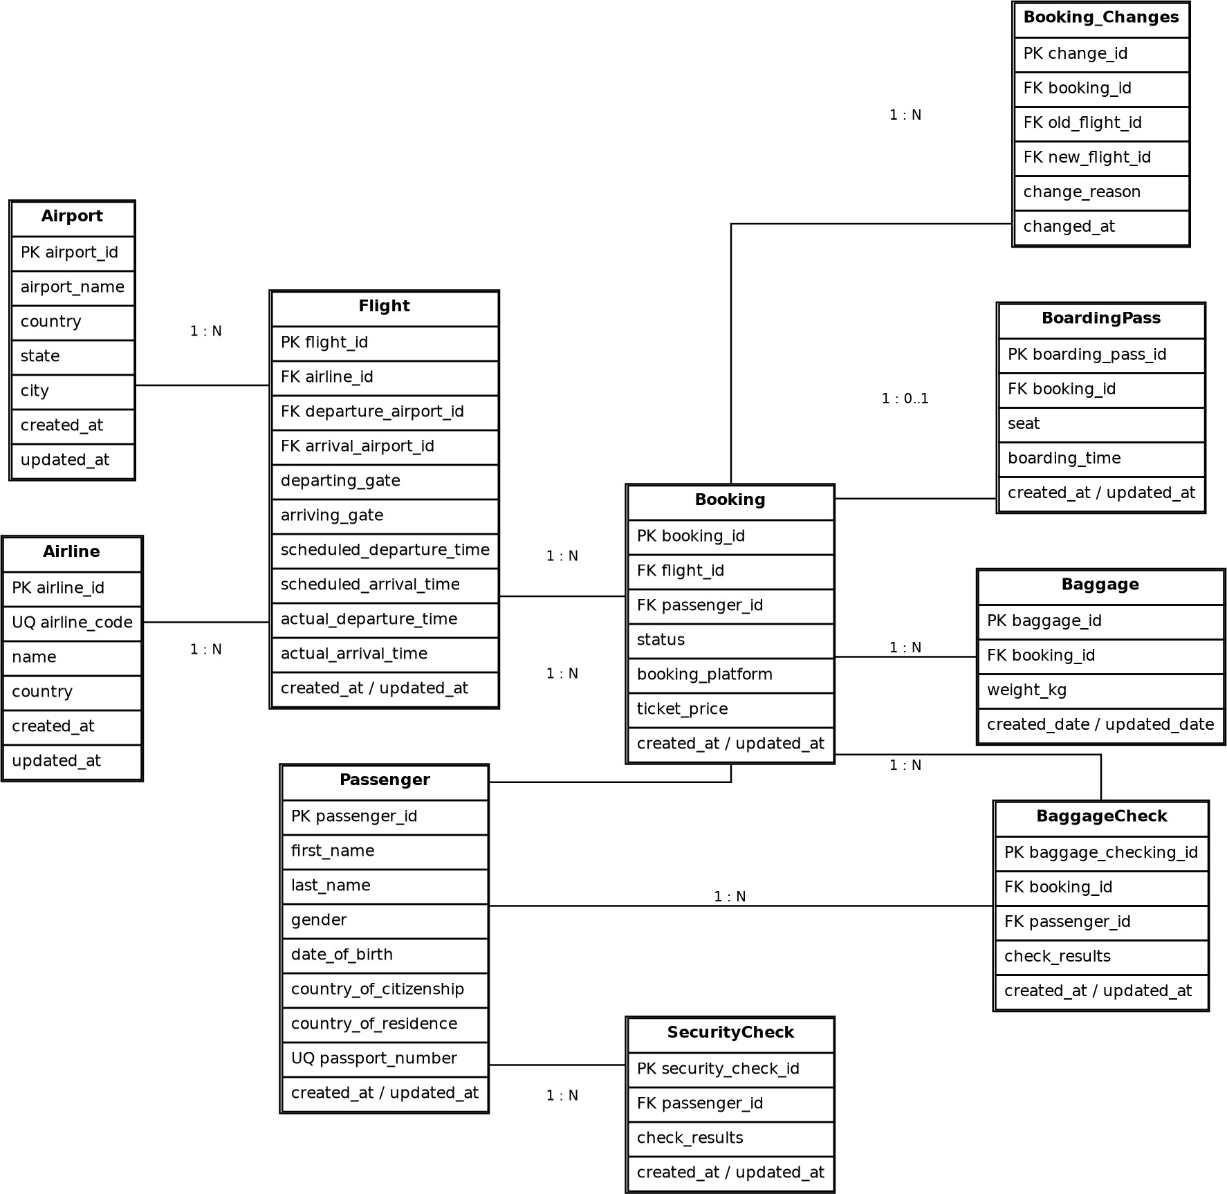
5. Entity-Relationship Diagram
PK means Primary Key, FK means Foreign Key, and UQ means Unique constraint.

Slide 7
6. ERD Legend / Notation 7. Conclusion
Overall, this diagram shows how the airport database works. Primary and foreign keys make sure all the data stays accurate and connected. It splits everything into clean tables like passengers, baggage, and flights, making it easy to implement in PostgreSQL.
Notation | Meaning
PK | Primary Key - uniquely identifies a row.
FK | Foreign Key - references a primary key in another entity.
UQ | Unique constraint - prevents duplicate values.
1 : N | One-to-Many relationship.
1 : 0..1 | One-to-zero-or-one relationship.
Required | Attribute is expected to contain a value.
Optional / NULL
Value may be absent, especially for actual flight times before a flight operates

